Slide 1



ISO9001 200millon pcs 30000 sqms
Quality System Rebar Coupler Factory Area

Slide 2
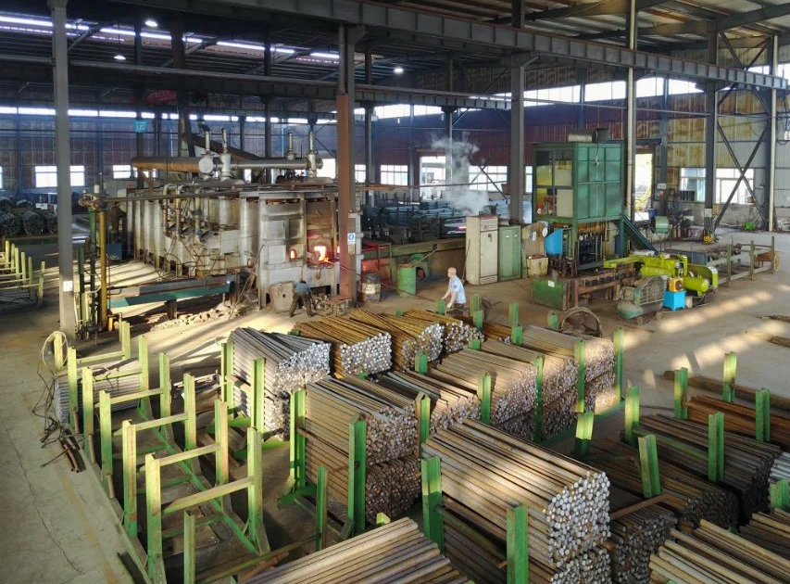
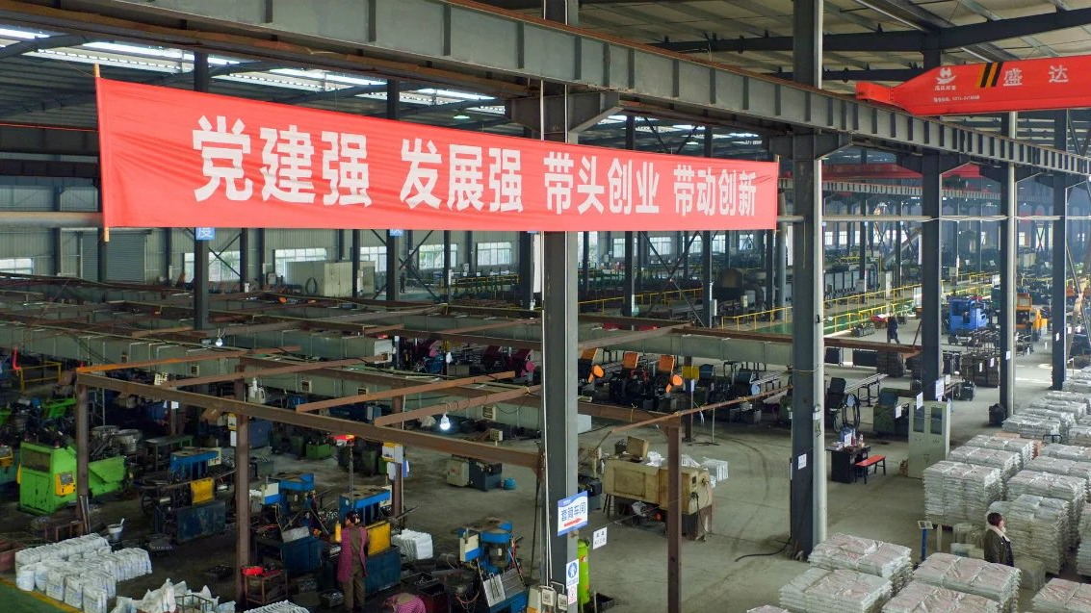
We are young！
We are strong!
Our mission:
Provide high-quality steel sleeves for world projects to make buildings stronger and safer

Slide 3
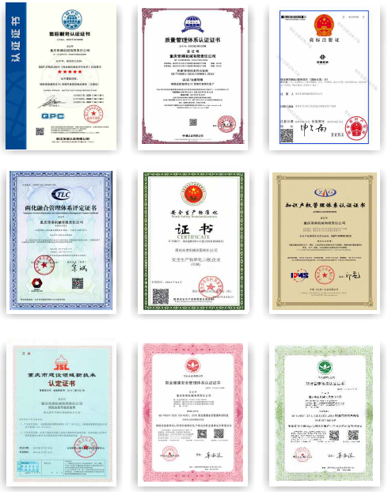
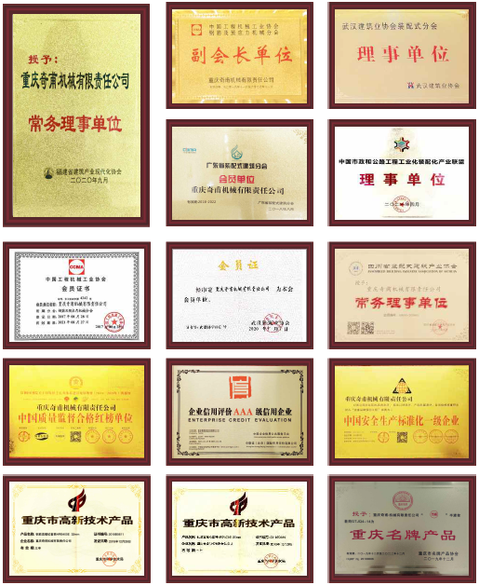
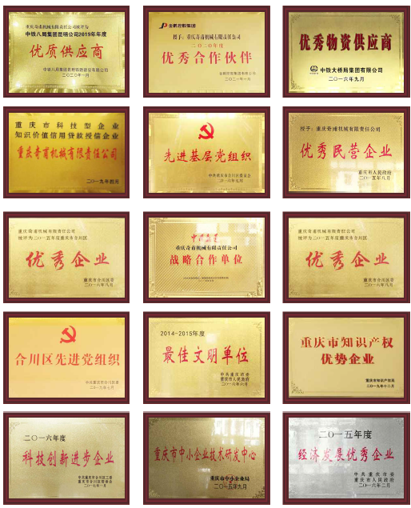
Our Certificate & Honor
16 Qualification certificates
43 Enterprise honors
31 design patents certificates

Slide 4
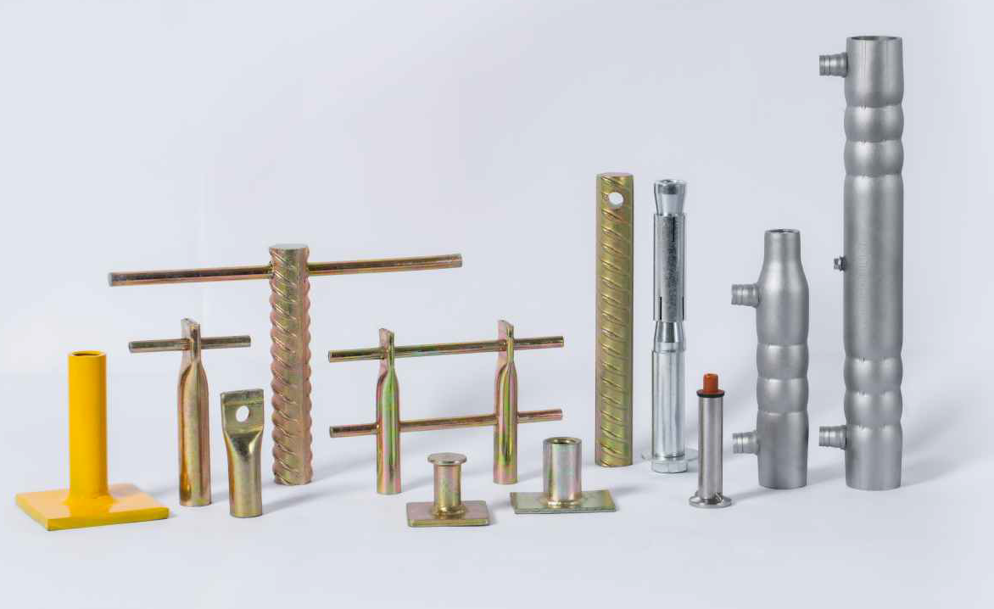
Grouted
Coupler
Series

Slide 5
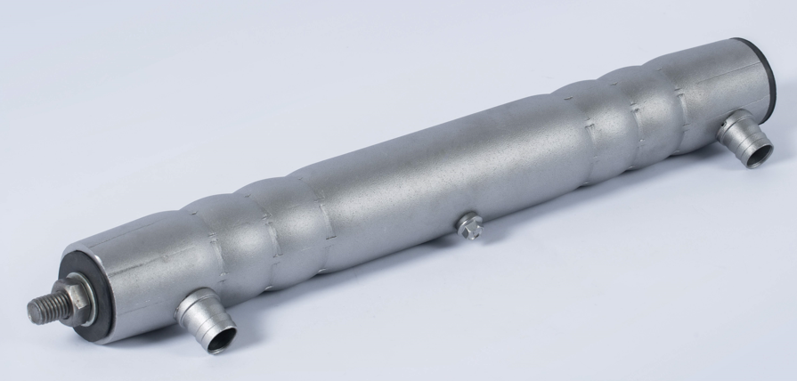
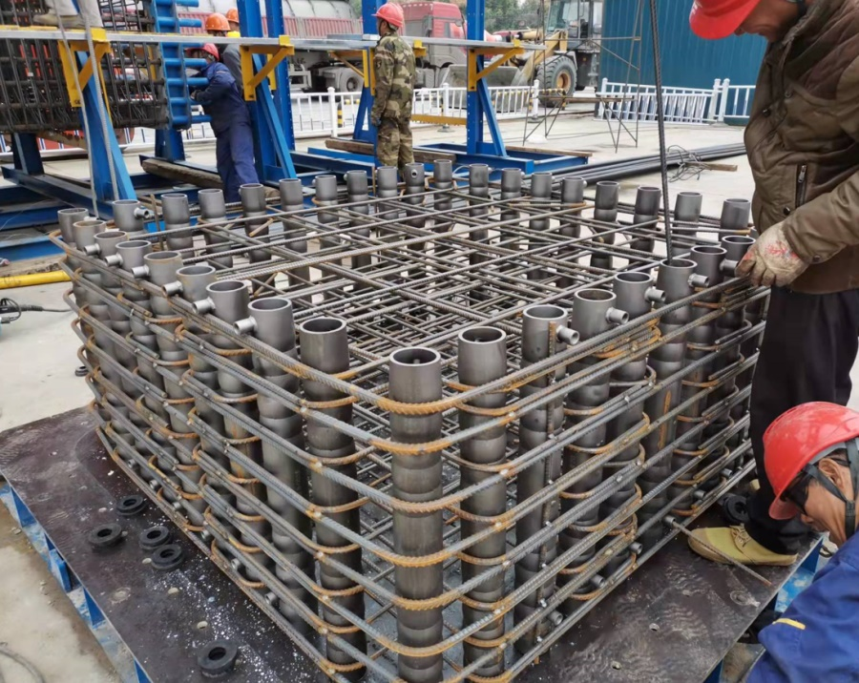
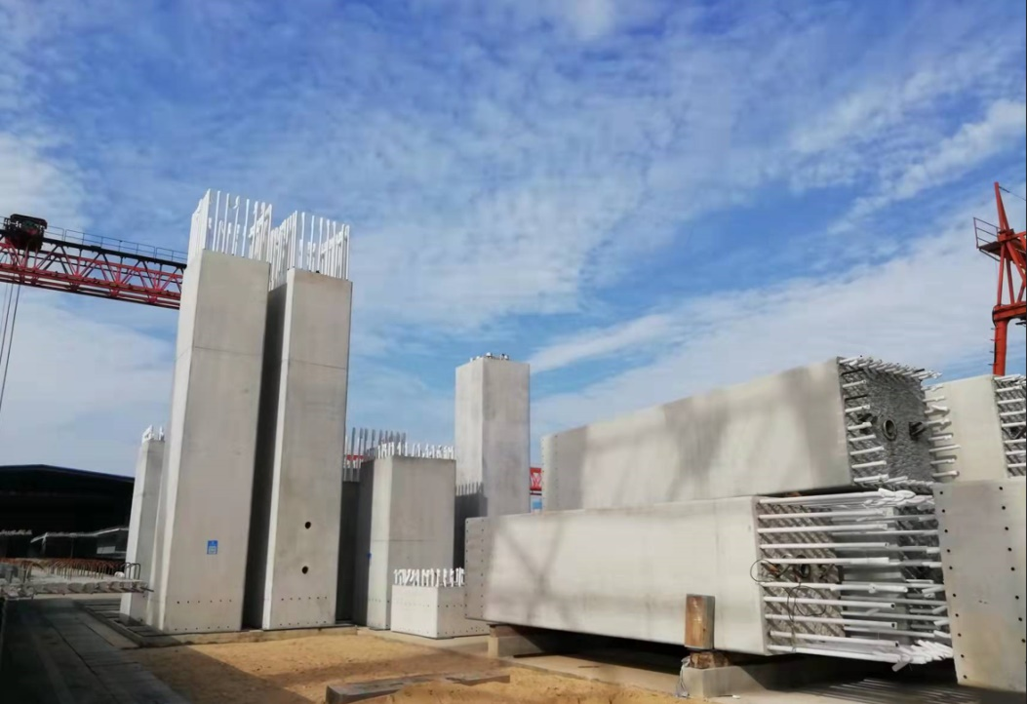
Grout coupler for bridge
Full grouted sleeve is that
both ends of the cylinder are
grouted to connect the steel bar

Slide 6
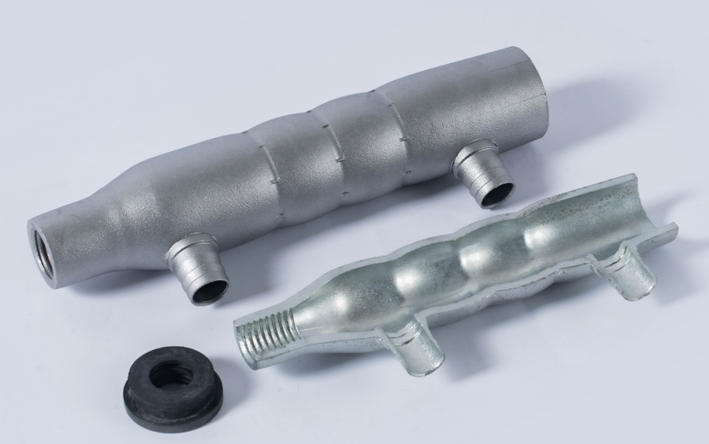
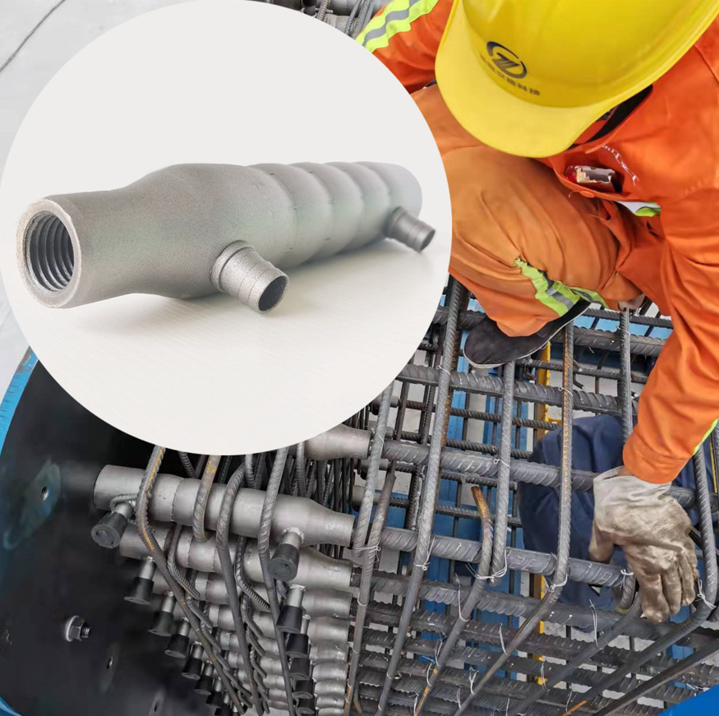
Half-grout Sleeve
Semi-grouted coupler is that one end of the cylinder is connected by grouting, and the other end is connected by non-grouting

Slide 7
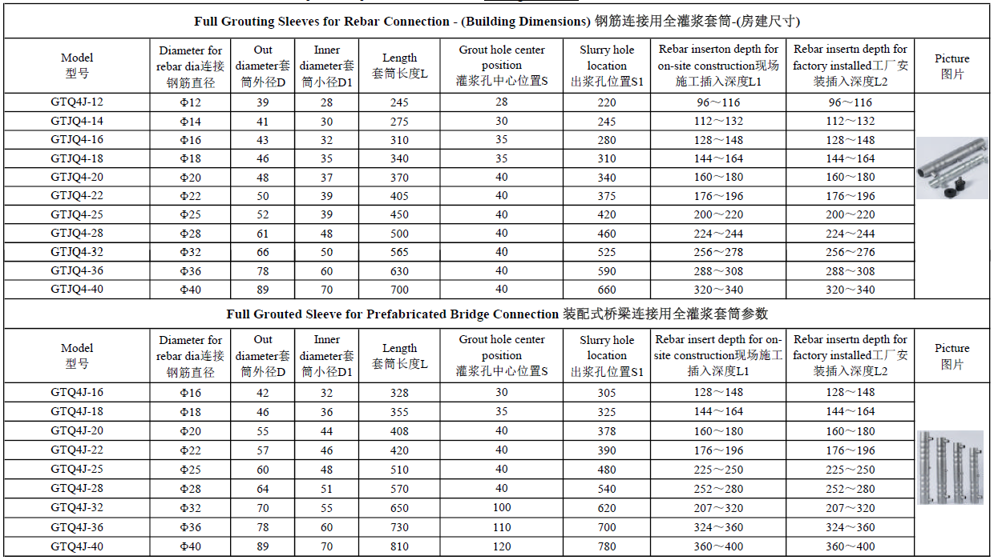

Slide 8
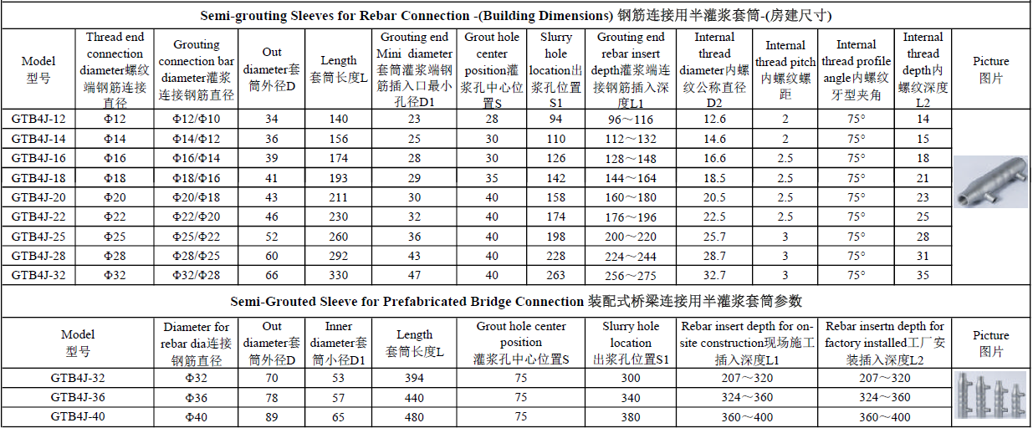

Slide 9
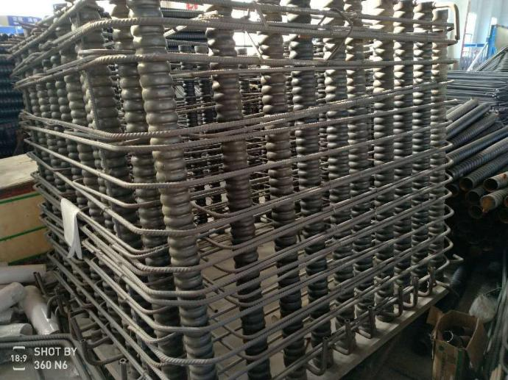
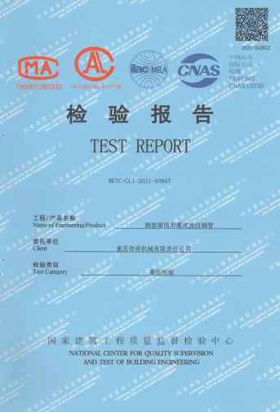
Bellows Grouting Sleeve for Cover Beam Anchorage
Corrugated Duct Grouting Coupler for Bent Cap Anchorage
Corrugated duct out diameter D/mm | 89±2 |  | Rebar diameter /mm | 28 / 32 / 36 / 40
Coupler thickness t/mm | 2±0.5 |  | corrugated height a/mm | 3~5
Sealing plate thickness t2/mm | 3 |  | Length L/mm | Not less than 24 times of rebar diameter
The distance of the grouting hole and the exhaust hole from the end c/mm | 50 |  | corrugated distance p/mm | 32

Slide 10
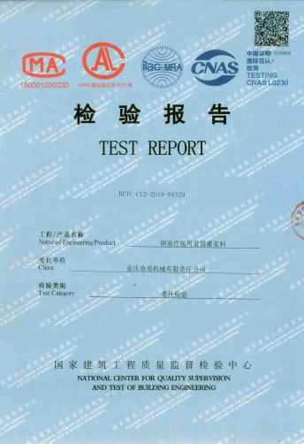
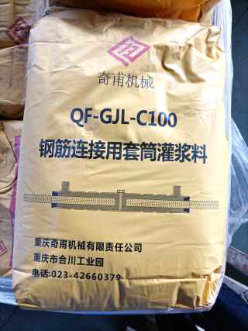

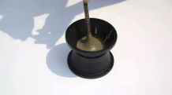
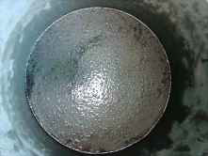
Cementitious Grout for Sleeve of Rebar Splicing
Different type grouts for low / normal/ high temperature based on
JG/T 408-2019 quality standard.

Slide 11
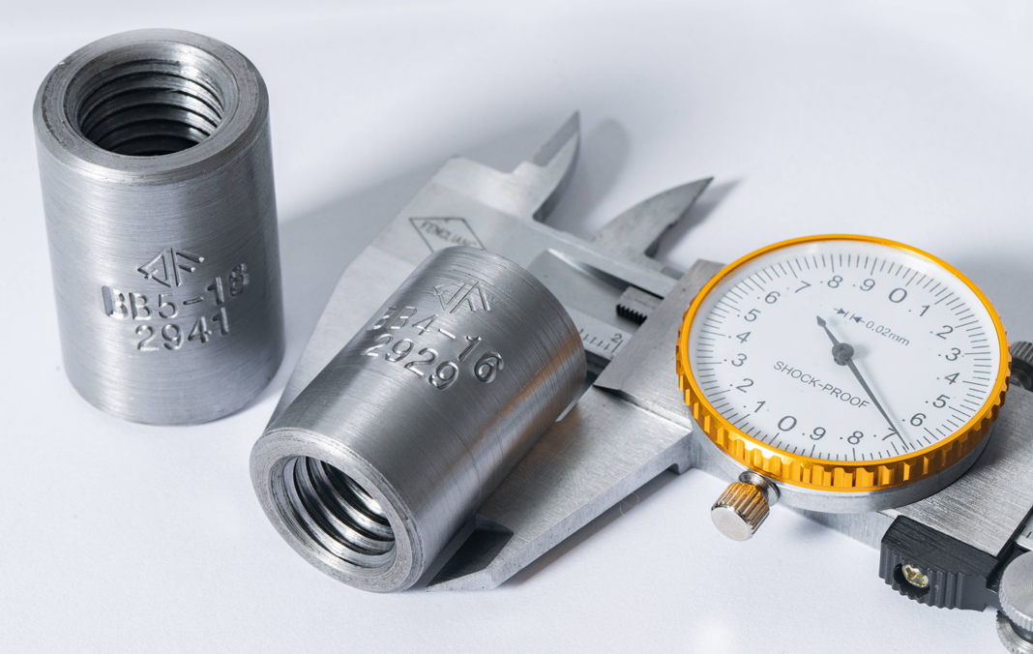
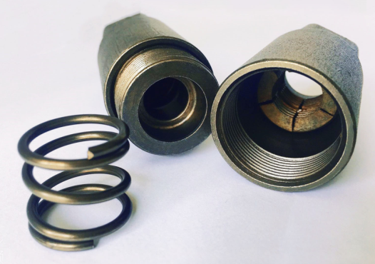
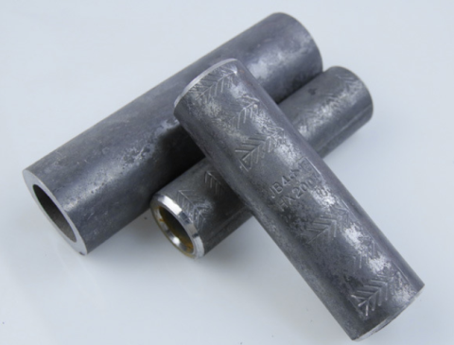
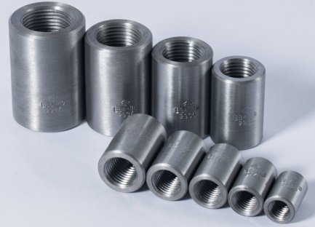
Straight Thread Rebar Coupler Series
It’s the most popular and widely used type coupler
in rebar connection,
 | Diameter requirements
Rebar diameter (mm) | 12 | 14 | 16 | 18 | 20 | 22 | 25 | 28 | 32 | 36 | 40 | 50
Coupler diameter(mm) | 12 | 14 | 16 | 18 | 20 | 22 | 25 | 28 | 32 | 36 | 40 | 50

Slide 12
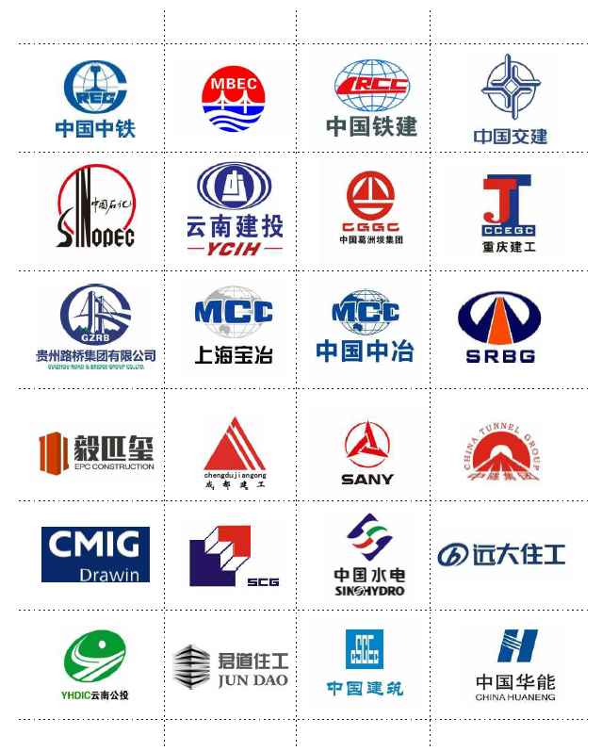
Several years, we are always
cooperated with Chinese
government enterprises like:
China Railway Construction
Corporation Limited
China Railway Engineering Group
Limited
China Communications Construction
Co., Ltd
China State Construction Engineer
Corporation
China Petroleum & Chemical
Corporation
China Metallurgical Group Corp
Chongqing Construction Engineering
Group Co., Ltd

Slide 13
